Slide 1

24CSEN2001 : DATA STRUCTURES LAB
CASE STUDY
NATIONAL BLOOD AND ORGAN DONATION NETWORK

Slide 2
Batch Number - 10
REGISTRATION NUMBER | NAME OF THE STUDENT
2024002556 | BONDI VENKATA LIKHITA
2024040399 | A.VENKATA GAYATHRI HARSHMITHA
2024109451 | G.HASINI
2024113620 | PEDDINA MOHITHA
2024131891 | BOTTA SNEHITHA

Slide 3
Abstract
The National Blood and Organ Donation Network is an advanced digital platform designed to seamlessly connect donors, recipients, and hospitals in real time.
The system’s primary goal is to minimize delays in finding compatible donors and ensure timely and life-saving medical interventions. By integrating a secure and centralized database, it facilitates donor registration, organ availability tracking, and blood stock management across healthcare facilities.
Through efficient data management, real-time updates, and networked communication between medical institutions, this system exemplifies how technology can revolutionize healthcare and save countless lives by streamlining the donation and transplantation process.
This case study highlights how technology can save lives through efficient data management and network communication between healthcare institutions.

Slide 4
Introduction:
The shortage of blood and organs is a major concern in the healthcare system.
Many patients lose their lives due to delays in finding compatible donors.
To address this issue, a centralized digital platform is proposed to connect donors, recipients, and hospitals efficiently.
Objectives:
Build a central donor–recipient network.
Reduce donor search time and response delays.
Maintain real-time blood and organ availability.
Encourage voluntary donations through awareness.

Slide 5
Methodology/Architecture
The system includes several modules such as user registration, database management, matching algorithm, notification system, and admin dashboard. The system architecture allows donors and patients to be connected through a centralized database with a matching engine that calculates compatibility scores based on medical and geographical data.

Slide 6
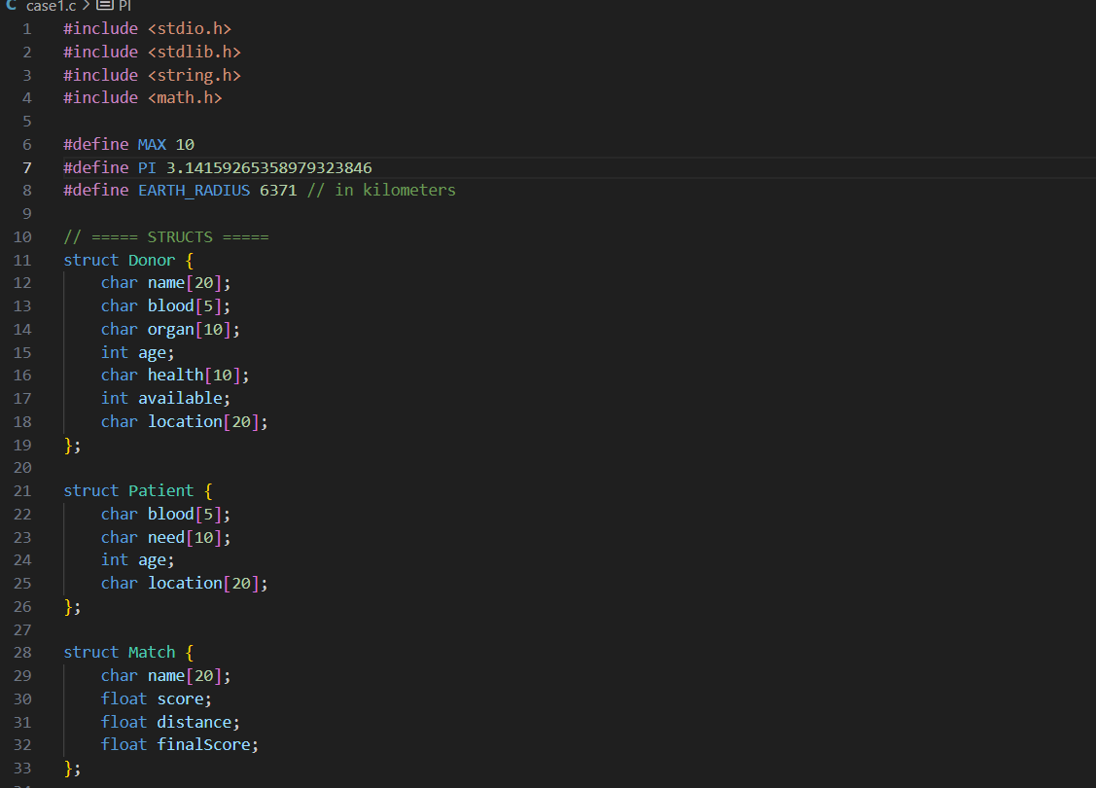
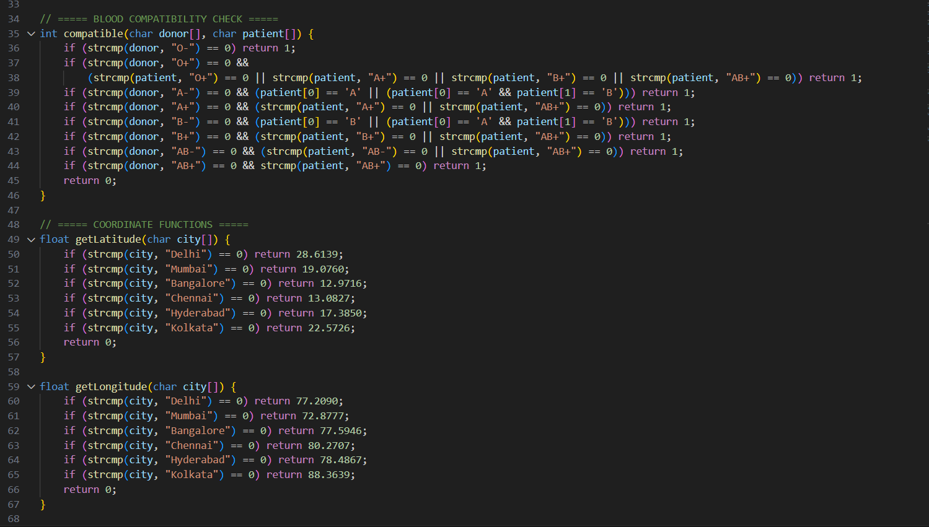
Program

Slide 7
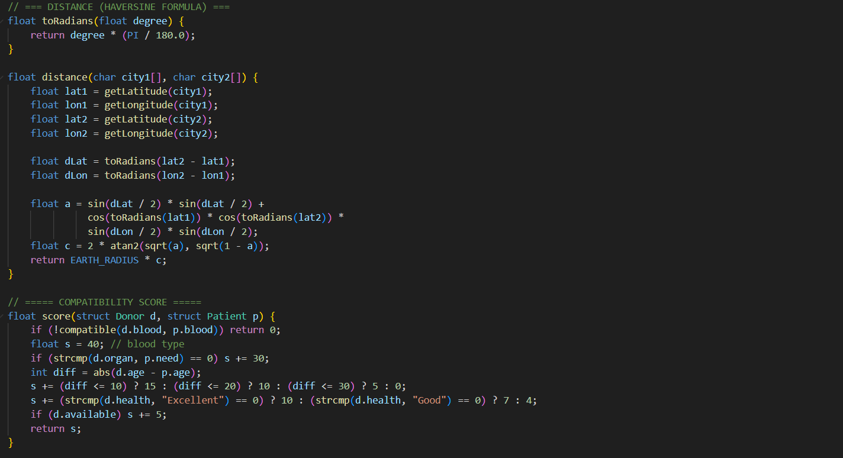
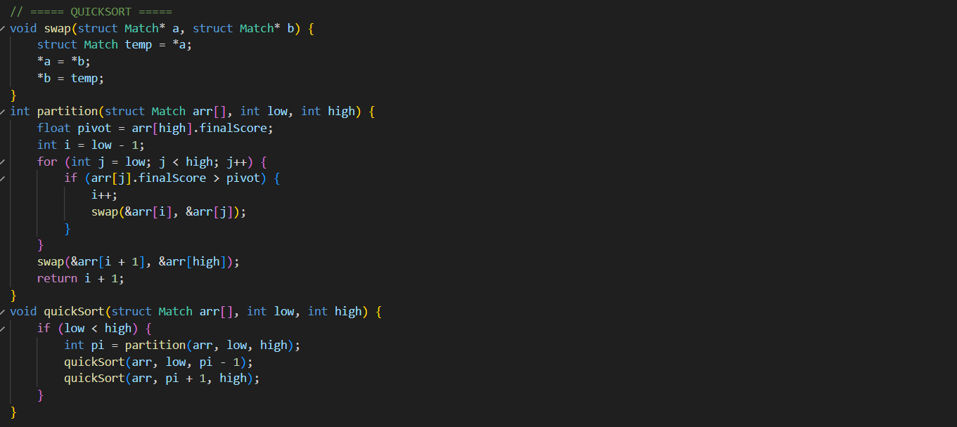

Slide 8
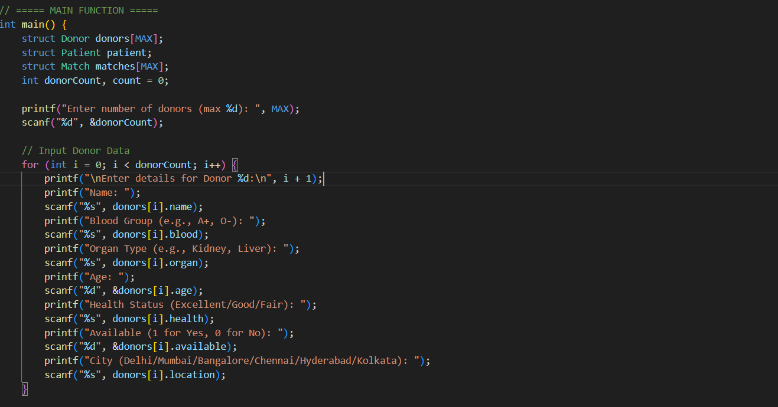
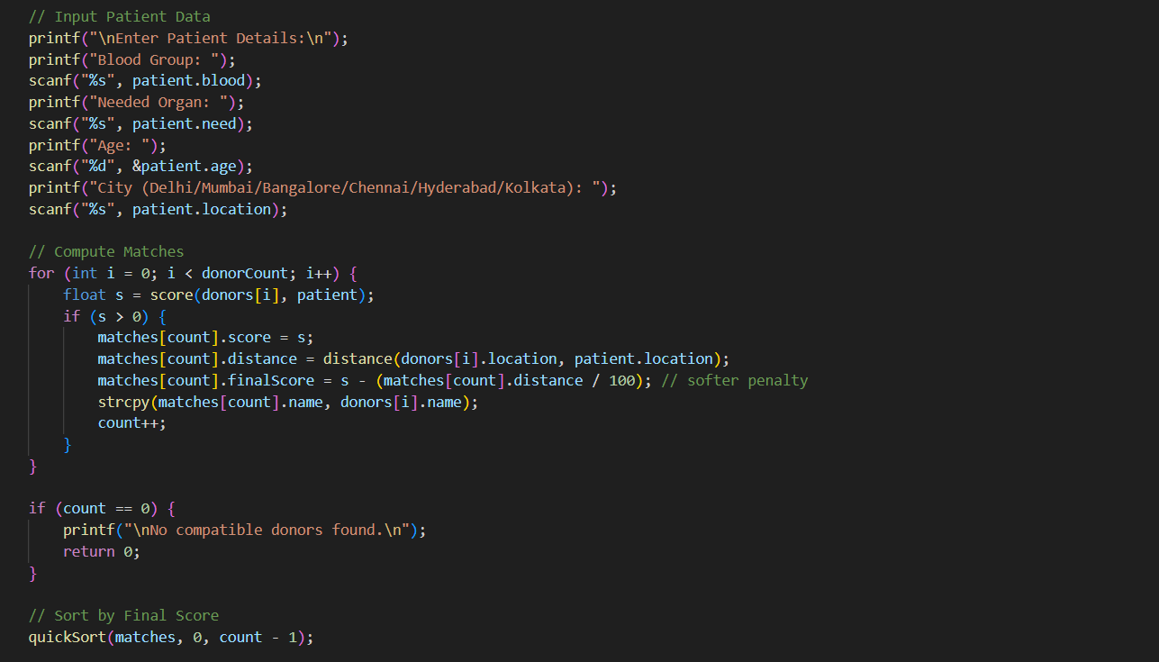

Slide 9
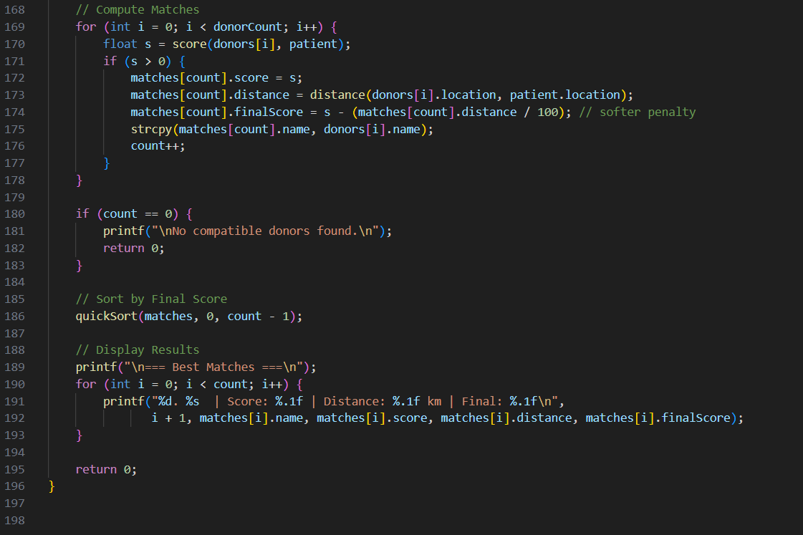

Slide 10
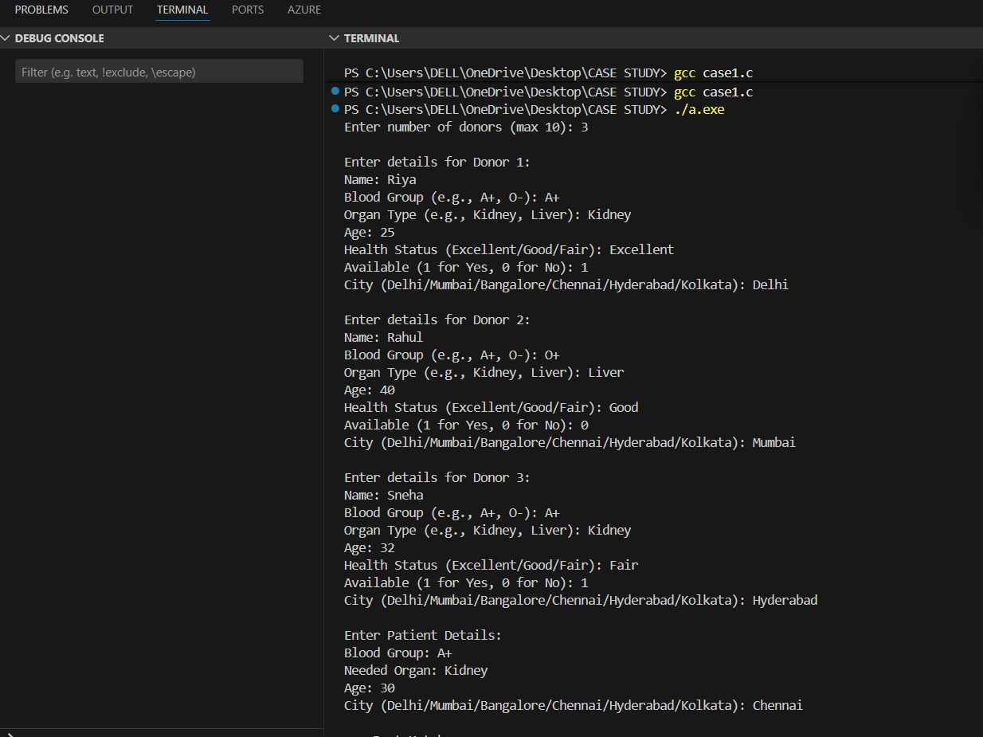
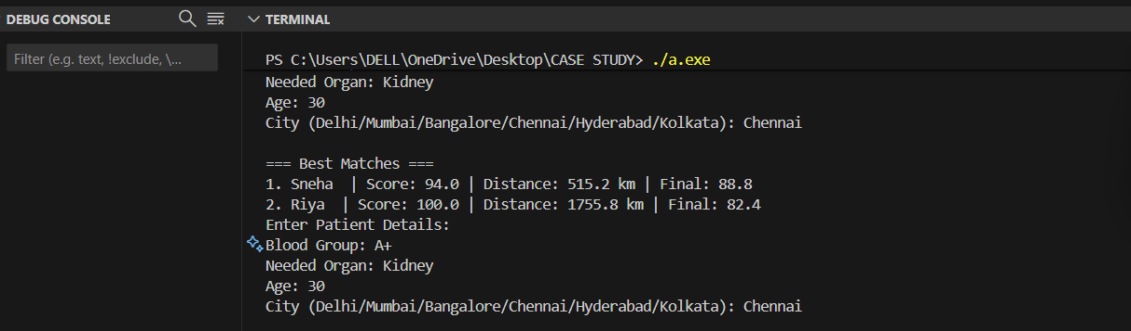
Results ( Input and Output )

Slide 11
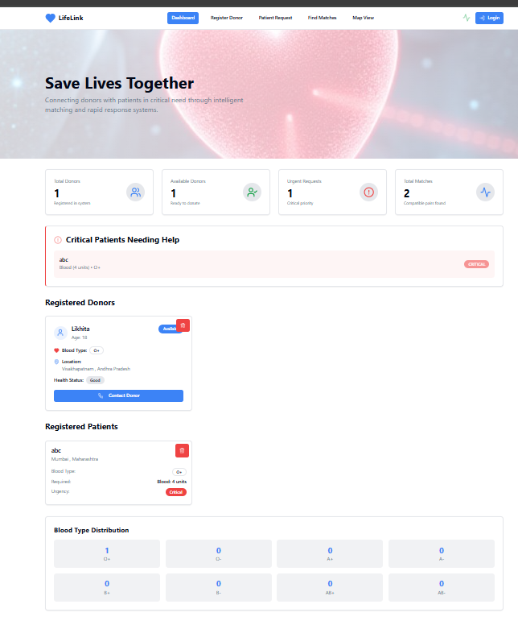
Web Application Results
Main webpage

Slide 12
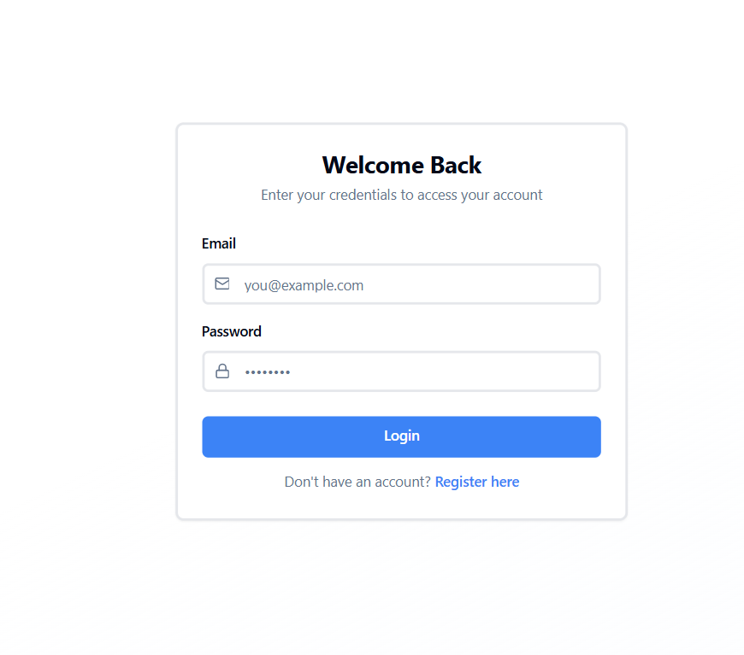
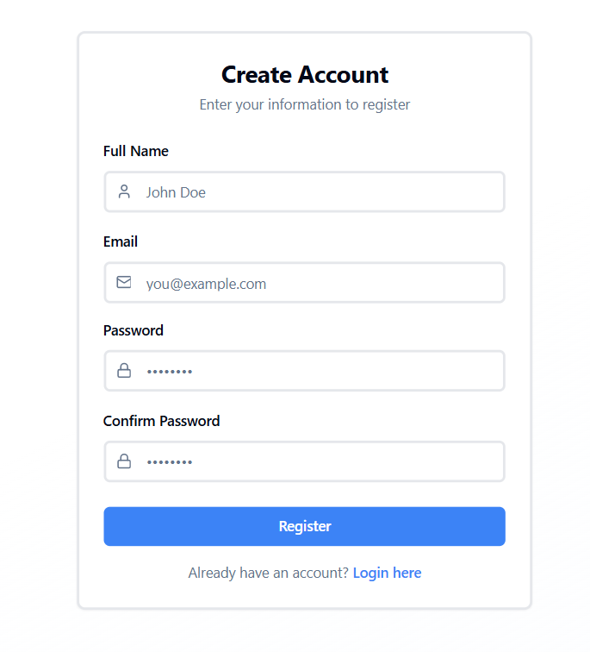
Login Page
Register Page

Slide 13
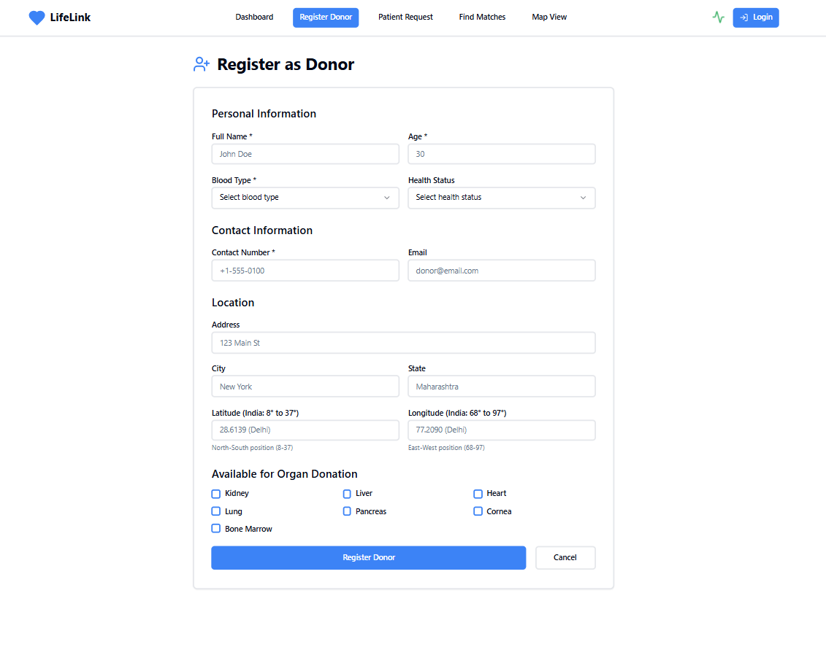
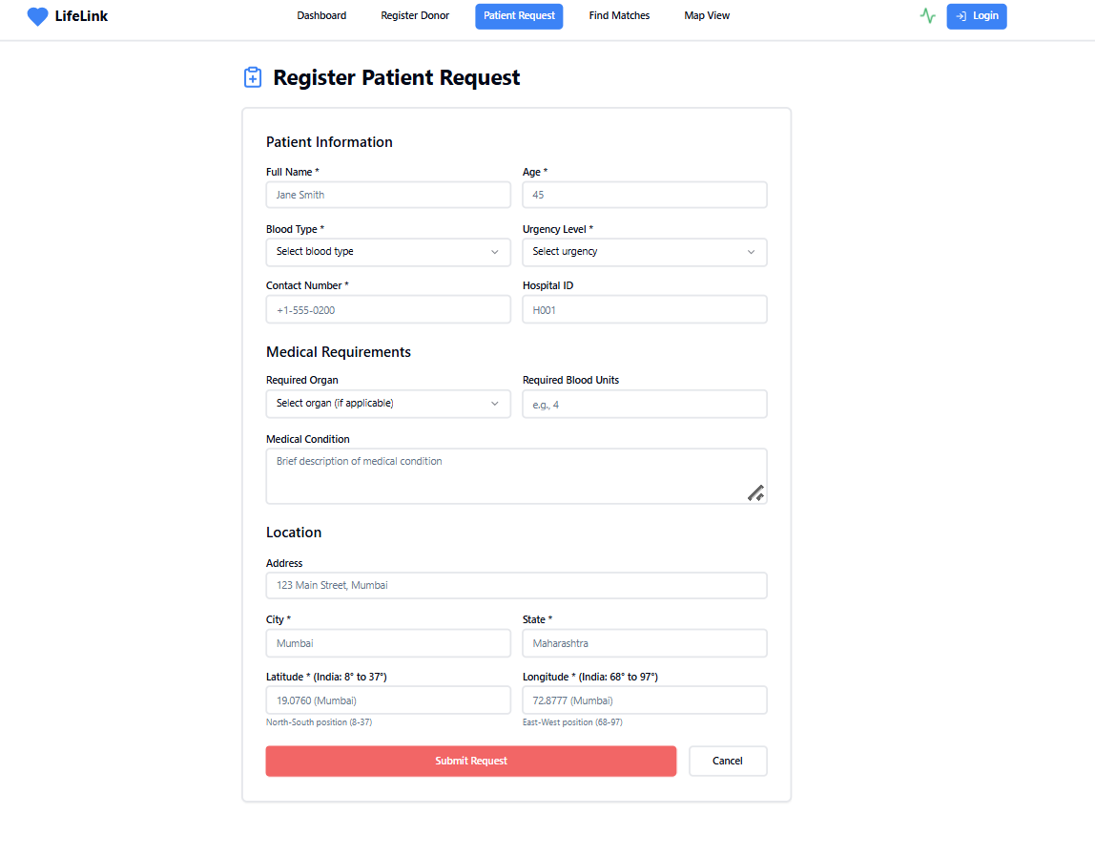
Register as Donor
Register as Patient

Slide 14
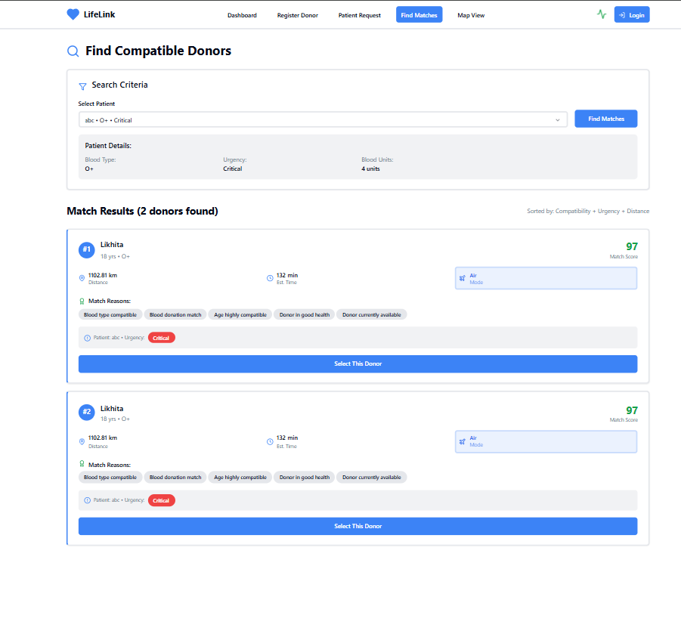
Compatible Matches

Slide 15
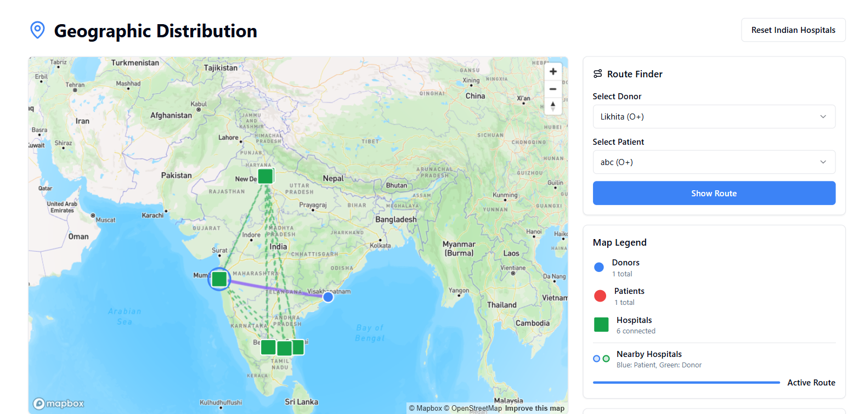
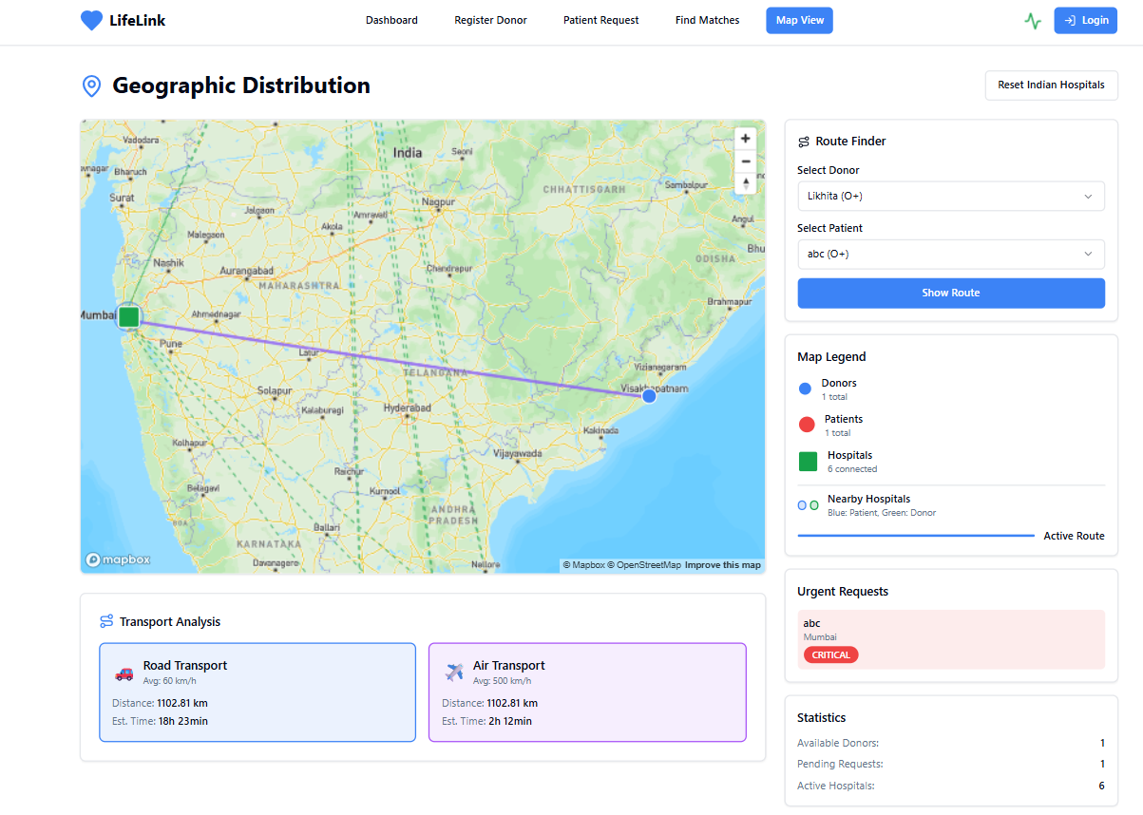
Map View of the Donor(Visakhapatnam) and Patient(Mumbai) with the top hospitals across India and the total distance through modes of travel i.e air & water along with estimated time for each mode.
Map View of the Donor(Visakhapatnam) and Patient(Mumbai) with the top hospitals across India.

Slide 16
Conclusion
The National Blood and Organ Donation Network provides a unified digital solution to bridge the gap between donors and recipients. It enhances efficiency, reduces response time, and saves lives. Future versions can include features like GPS-based donor tracking, AI-based compatibility prediction, and mobile app integration for accessibility.

Slide 17
References
[1] https://www.nhp.gov.in
[2] //www.who.int/health-topics/blood-safety
[3] https://www.geeksforgeeks.org

